Slide 1
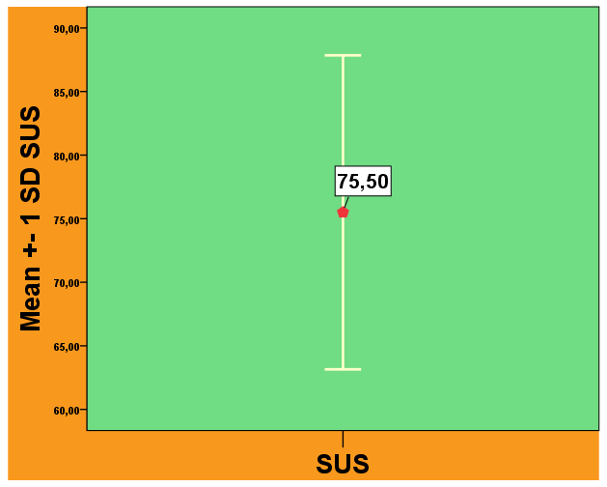
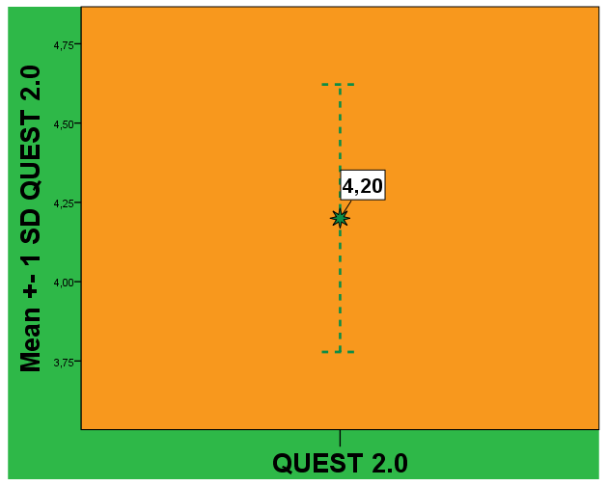
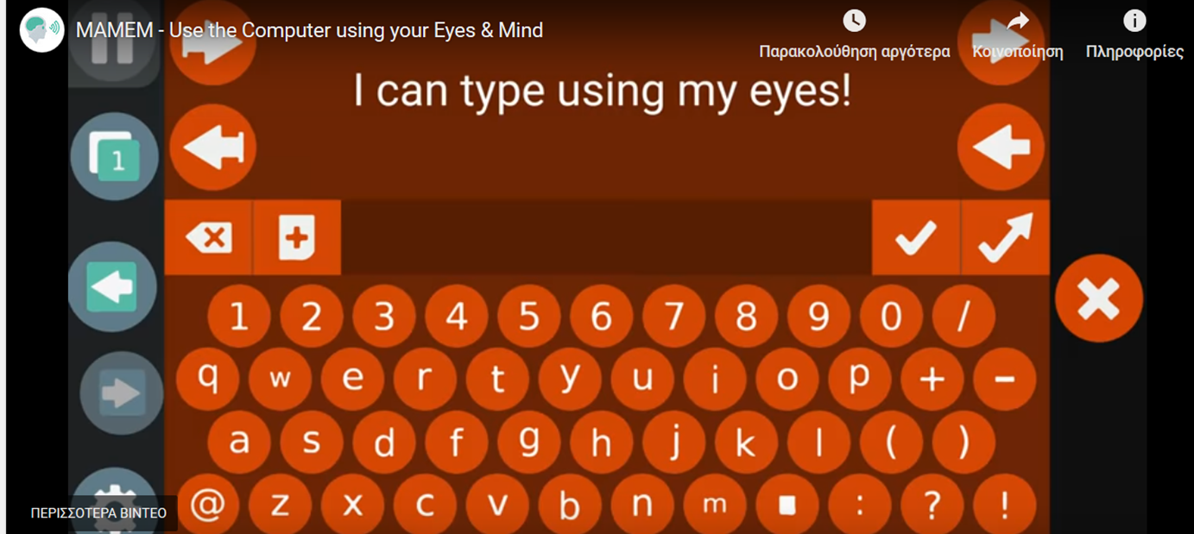
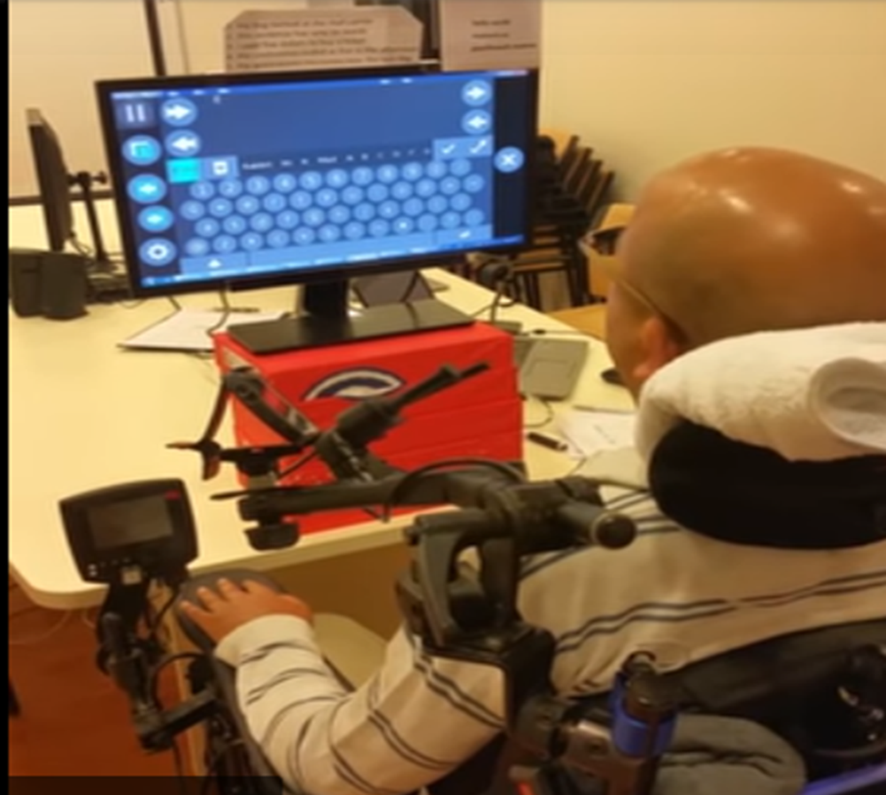
Parkinsonian patients’ experiences operating the computer with their eyes: the MAMEM Project
Sevasti Bostantjopoulou-Kambouroglou¹, Zoe Katsarou¹, Meir Plotnik² ,Gabi Zeilig³, Ioannis Daglis¹ ,George Liaros ⁴, Fotios Kalaganis⁴ , Konstantinos Georgiadis⁴ ,Yiannis Kompatsiaris⁴ ,Spiros Nikolopoulos⁴.
¹Aristotle University of Thessaloniki, ²Center of Advanced Technologies in Rehabilitation, Sheba Medical Center, ³Sheba Medical Center, ⁴CERTH
Objectives: The purpose of this study ,that is the EU Horizon 2020,MAMEM project (Multimedia
Authoring and Management using your Eyes and Mind)¹⁻⁴, is to provide Parkinson’s disease (PD) patients innovating technology that will enable them to have a better use of the computers, through mental commands and gaze activity. Here we report the patients’ perspective from their attempts to operate the computer by using their eyes only.
Background:
The use of computers and information technologies is essential for social participation and productive life. Although PD patients consider computer use as an important part of their everyday life they face many operational difficulties and significant obstacles in computer operation.
Methods:
A.Patients selection:Ten patients with Parkinson disease entered the study.There were six men and four women with an average age of 55.6 years and 10 years of disease duration. They were in an average 2.1 stage of the disease according to the Hoehn and Yahr scale .All of them had bilateral arm rigidity and
bradykinesia, four had bilateral arm tremor and all had dyskinesias. Most of them (90%) reported of slight to medium interference of their clinical condition on the computer operation .
B.Procedure: A laptop computer with the MAMEM platform* ,including the GazeTheWeb browser* installed on it, as well as a SenseMotoric Instruments** remote eye-tracker was given to the patients for a period of one month to use at their homes. The patients received training how to operate the computer through the eyes before the trial and could have technical assistance in case of system failure.All patients signed an informed consent form for this trial.
C.Evaluation:User satisfaction and perceived usability of the system, were measured by the QUEST 2.0⁴ [Quebec User Evaluation of Satisfaction with assistive Technology ]and the System Usability Scale (SUS)⁵ questionnaires. The QUEST 2.0 final score ranges between 1-5 (1=not satisfied at all; 5= highly satisfied).. The SUS score ranges between 0-100, and a SUS score above a 68 would be considered above average and anything below 68 is below average.
NOTE:* www.mamem.eu ;** www.smivision.com/eyetracking
Results:
The MAMEM platform was perceived by the patients as a useful, usable and
satisfactory assistive device that enables computer usage and digital
social activities. Most of the patients found the platform useful, easy to learn and manageable. They enjoyed it and they reported that usage was getting
easier and faster as time went up. They concluded that MAMEM is a great tool for people with disabilities. Their scores in SUS and QUEST-2.0 questionnaires are presented in figures 3 & 4.
However some patients complained of technical problems that had to do with the hardware technology such as need to restart the program due to frequent crashes and re-calibration of the eye-tracker.
FIG.3:
Mean SUS score for the MAMEM platform
FIG.4:
Mean QUEST-2 score for the MAMEM platform
Conclusions:
The MAMEM platform joins the family of assistive devices for computer use for people with motor hand disabilities offering a unique way to surf the web and to participate in online social networks using eye movements.
People with PD will benefit from the new technology ,but further improvements are needed in order to make this new device as user-friendly as possible and most adjusted to every patient’s needs and expectations.
Fig.1: Gaze
Based key -board
Fig.2: Computer operation through the eyes using the Gaze
TheWeb browser
REFERENCES
1.C. Kumar, R. Menges and S. Staab, Eye-Controlled Interfaces for Multimedia Interaction, in IEEE MultiMedia, vol. 23, no. 4, pp. 6-13, Oct.-Dec. 2016. doi: 10.1109/MMUL.2016.52
2.Nikolopoulos S, Petrantonakis PC, Georgiadis K, et al. A multimodal dataset for authoring and editing multimedia content: The MAMEM project.Data Brief. 2017 Nov 3;15:1048-1056. doi: 10.1016/j.dib.2017.10.072. eCollection 2017 Dec
3.D5.3 – Final design and implementation of the prototype interface applications, (2018).MAMEM Consortium, url: http:// mklab.iti.gr /mamem/images/e/e0/D5.3_Final design and implementation of the prototype interface applications.pdf
4.Demers, L., Weiss-Lambrou, R., & Ska, B. (2002). The Quebec User Evaluation of Satisfaction with Assistive Technology (QUEST 2.0): an overview and recent progress.Technology and Disability, 14(3), 101-105.
5.Brooke, J. (1996). SUS-”A quick and dirty” usability scale, Usability Evaluation in Industry,189 (194): 4 – 7.
[
Disclosure:
This research has been supported by a grant for MAMEM(Multimedia Authoring and Management using your Eyes and Mind)project.This is a European Community Horizon 2020 project (project code: H2020-ICT-2014-644780).

